Slide 1
Lesson plans for Genesis 12-17
Antonio Chaves

Slide 2
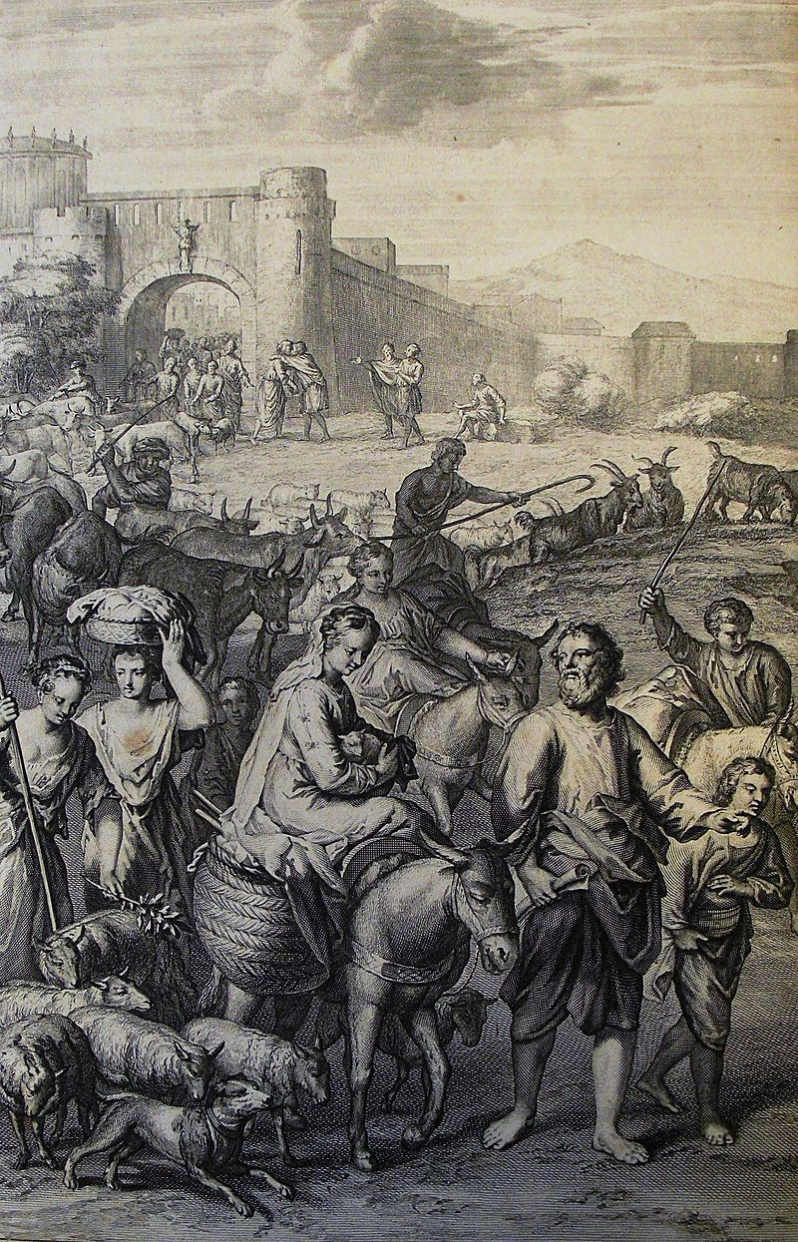
Genesis 12: 1-4
¹Now Yahweh said to Abram, “Leave your country, and your relatives, and your father’s house, and go to the land that I will show you. ²I will make of you a great nation. I will bless you and make your name great. You will be a blessing. ³I will bless those who bless you and curse those who treat you with contempt. All the families of the earth will be blessed through you.”
⁴So Abram went as Yahweh had told him. Lot went with him. Abram was seventy-five years old when he departed from Haran.

Slide 3
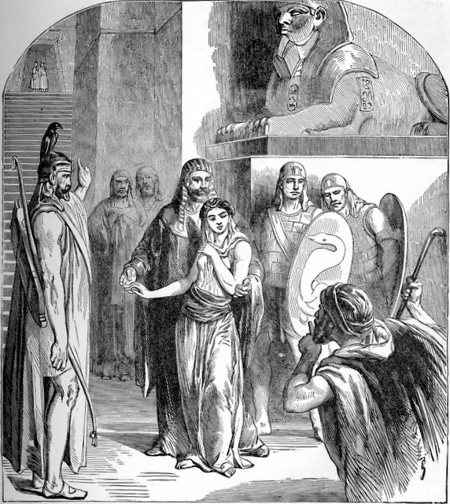
Genesis 12: 10-20
¹⁰There was a famine in the land. Abram went down into Egypt to live as a foreigner there, for the famine was severe in the land. ¹¹When he had come near to enter Egypt, he said to Sarai his wife, “See now, I know that you are a beautiful woman to look at. ¹²It will happen that when the Egyptians see you they will say, ‘This is his wife.’ They will kill me, but they will save you alive. ¹³Please say that you are my sister, that it may be well with me for your sake and that my soul may live because of you.”
¹⁴When Abram had come into Egypt, Egyptians saw that the woman was very beautiful. ¹⁵The princes of Pharaoh saw her and praised her to Pharaoh; and the woman was taken into Pharaoh’s house. ¹⁶He dealt well with Abram for her sake. He had sheep, cattle, male donkeys, male servants, female servants, female donkeys, and camels. ¹⁷Yahweh afflicted Pharaoh and his house with great plagues because of Sarai, Abram’s wife. ¹⁸Pharaoh called Abram and said, “What is this that you have done to me? Why didn’t you tell me that she was your wife? ¹⁹Why did you say, ‘She is my sister,’ so that I took her to be my wife? Now therefore, see your wife, take her, and go your way.” ²⁰Pharaoh commanded men concerning him, and they escorted him away with his wife and all that he had

Slide 4
Questions
What does God mean when he says, “I will bless those who bless you and curse those who treat you with contempt”. Can you provide some historical examples of people who paid a price for their Jew hatred?
Why did Abram say to the Egyptians that Sarai was his sister?
Abram feared he would be killed by if they knew Sarai was his wife. Most of us find this shocking, but can you think of historical examples of this kind of behavior?

Slide 5
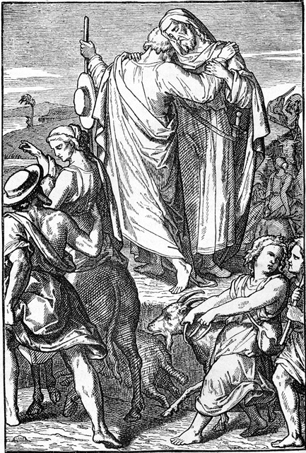
Genesis 13: 5-9
⁵Lot also, who went with Abram, had flocks, herds, and tents. ⁶The land was not able to bear that they might live together for their possessions were so great. ⁷There was strife between the herdsmen of Abram’s livestock and the herdsmen of Lot’s livestock. The Canaanites and the Perizzites lived in the land at that time. ⁸Abram said to Lot, “Please, let there be no strife between you and me and between your herdsmen and my herdsmen; for we are relatives. ⁹Isn’t the whole land before you? Please separate yourself from me. If you go to the left hand, then I will go to the right. Or if you go to the right hand, then I will go to the left.”

Slide 6
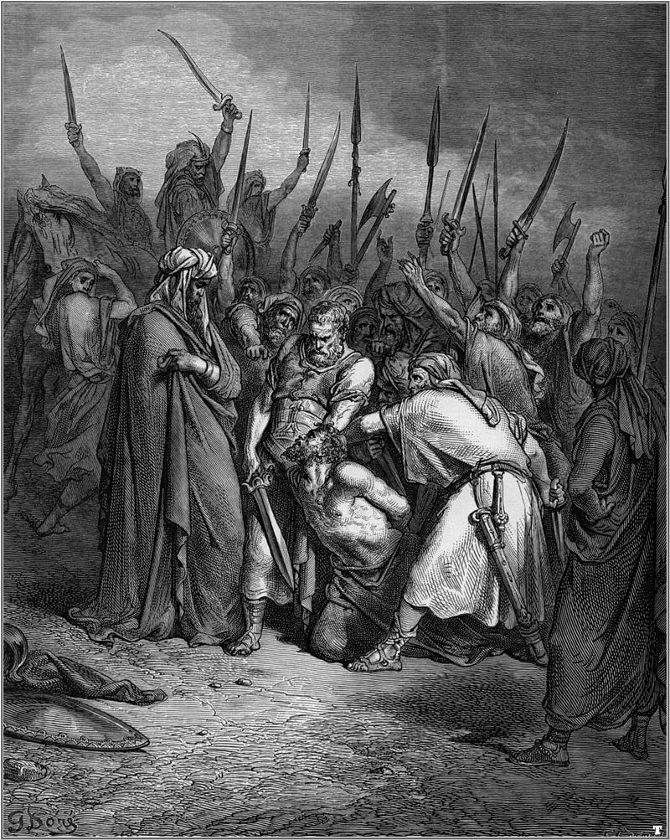
Genesis 14: 1-2, 11-12, 14-16
¹In the days of Amraphel, king of Shinar; Arioch, king of Ellasar; Chedorlaomer, king of Elam; and Tidal, king of Goiim, ²they made war with Bera, king of Sodom; Birsha, king of Gomorrah; Shinab, king of Admah; Shemeber, king of Zeboiim; and the king of Bela (also called Zoar)….
¹¹They took all the goods of Sodom and Gomorrah, and all their food, and went their way. ¹²They took Lot, Abram’s brother’s son, who lived in Sodom, and his goods, and departed…. ¹⁴When Abram heard that his relative was taken captive, he led out his three hundred eighteen trained men, born in his house, and pursued as far as Dan. ¹⁵He divided himself against them by night, he and his servants, and struck them and pursued them to Hobah, which is on the left hand of Damascus. ¹⁶He brought back all the goods, and also brought back his relative Lot and his goods and the other people.

Slide 7
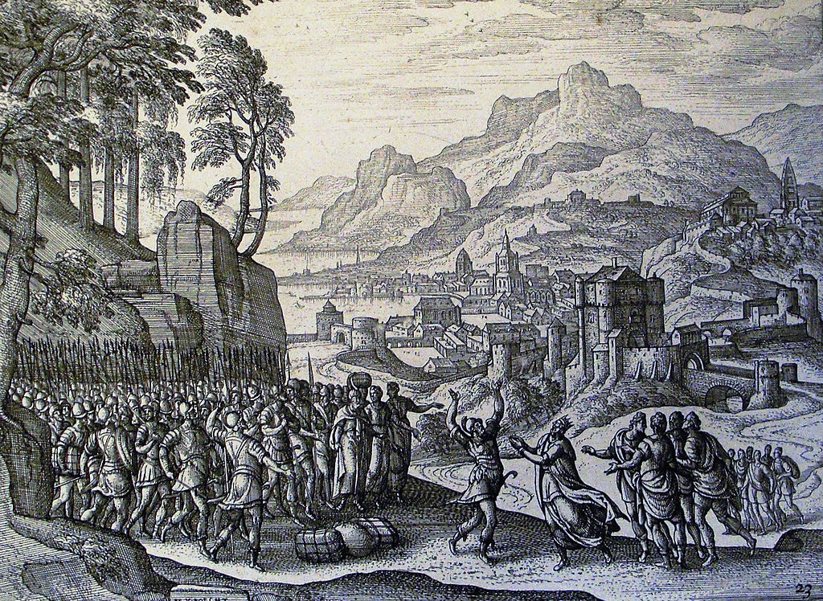
Genesis 14: 21-24
²¹The king of Sodom said to Abram, “Give me the people and take the goods for yourself.”
²²Abram said to the king of Sodom, “I have lifted up my hand to Yahweh, God Most High, ²³that I will not take a thread nor a sandal strap nor anything that is yours, lest you should say, ‘I have made Abram rich.’ ²⁴I will accept nothing from you except that which the young men have eaten, and the portion of the men who went with me: Aner, Eshcol, and Mamre. Let them take their portion.”

Slide 8
Questions
Why did Abram part ways with Lot?
What was Abram’s goal when he raised an army?
Why did Abram refuse to keep for himself the spoils from the war?

Slide 9
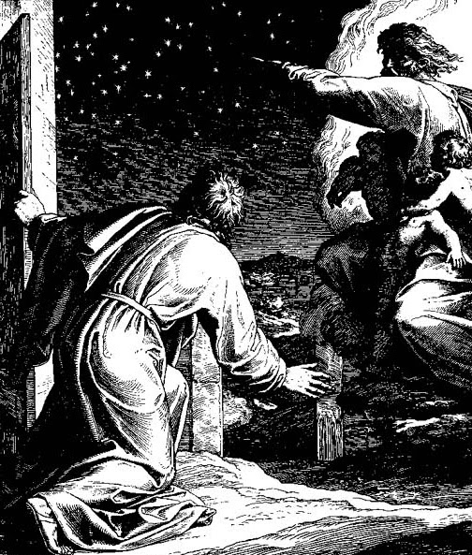
Genesis 15: 1-5
¹…. Yahweh’s word came to Abram in a vision, saying, “Don’t be afraid, Abram. I am your shield, your exceedingly great reward.”
²Abram said, “Lord Yahweh, what will you give me since I go childless, and the one who will inherit my estate is Eliezer of Damascus?” ³Abram said, “Behold, you have given no children to me: and behold, one born in my house is my heir.”
⁴Behold, Yahweh’s word came to him saying, “This man will not be your heir, but he who will come out of your own body will be your heir.” ⁵Yahweh brought him outside and said, “Look now toward the sky and count the stars if you are able to count them.” He said to Abram, “This is how numerous your offspring will be.”

Slide 10
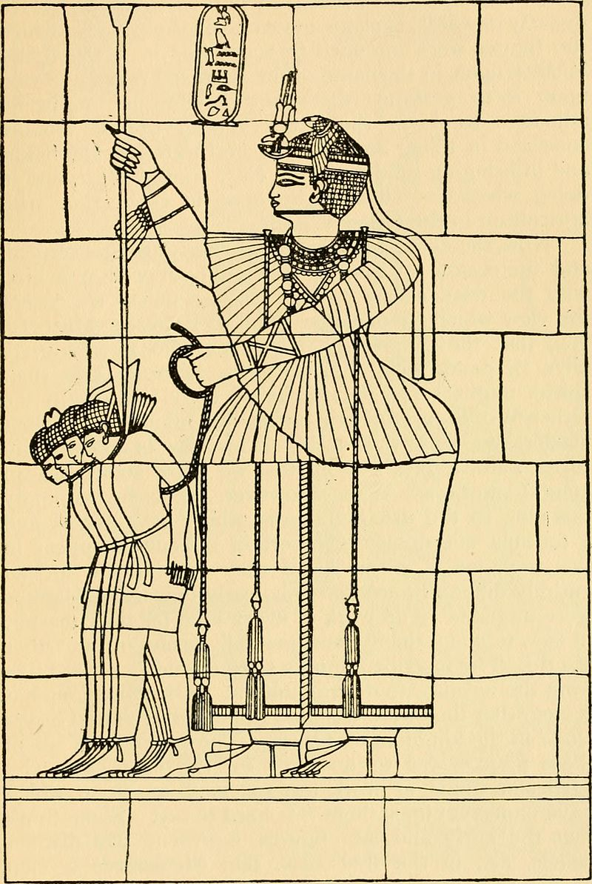
Genesis 15: 13-15, 18
¹³He said to Abram, “Know for sure that your offspring will live as foreigners in a land that is not theirs and will serve them. They will afflict them four hundred years. ¹⁴I will also judge that nation whom they will serve. Afterward they will come out with great wealth; ¹⁵but you will go to your fathers in peace. You will be buried at a good old age….
¹⁸In that day Yahweh made a covenant with Abram, saying, “I have given this land to your offspring, from the river of Egypt to the great river Euphrates…

Slide 11
Questions
What does God mean when he tells Abram that his descendants will be “foreigners in a land that is not their theirs”?
Why did God choose Abram?
What examples in his Abram’s behavior are key indicators as to the nature of his character?

Slide 12
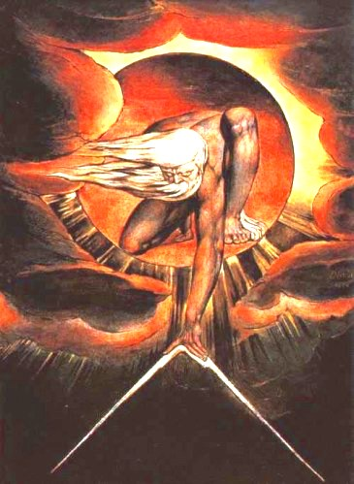
Genesis 17: 1-2, 5
¹When Abram was ninety-nine years old, Yahweh appeared to Abram and said to him, “I am God Almighty. Walk before me and be blameless. ²I will make my covenant between me and you, and will multiply you exceedingly.”…
⁵Your name will no more be called Abram, but your name will be Abraham; for I have made you the father of a multitude of nations.

Slide 13
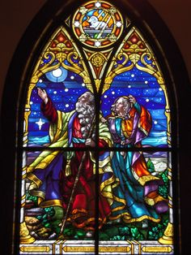
Genesis 17: 15-21
¹⁵God said to Abraham, “As for Sarai your wife, you shall not call her name Sarai, but her name shall be Sarah. ¹⁶I will bless her, and moreover I will give you a son by her. Yes, I will bless her, and she will be a mother of nations. Kings of peoples will come from her.”
¹⁷Then Abraham fell on his face, and laughed and said in his heart, “Will a child be born to him who is one hundred years old? Will Sarah, who is ninety years old, give birth?” ¹⁸Abraham said to God, “Oh that Ishmael might live before you!”
¹⁹God said, “No, but Sarah, your wife, will bear you a son. You shall call his name Isaac. I will establish my covenant with him for an everlasting covenant for his offspring after him. ²⁰As for Ishmael, I have heard you. Behold, I have blessed him and will make him fruitful, and will multiply him exceedingly. He will become the father of twelve princes, and I will make him a great nation. ²¹But I will establish my covenant with Isaac, whom Sarah will bear to you at this set time next year.”

Slide 14
Questions
Why did God change their names?
Who is Ishmael?
Why does God also bless Ishmael?

Slide 15
Acknowledgments:
Scripture verses were taken from the World English Bible and edited for clarity.
Unless otherwise indicated, all images were downloaded from Wikimedia.
Most of the questions are derived from commentary from “The Rational Bible: Genesis” by Dennis Prager.

