Slide 1
Lesson plans for Genesis 23-28
Antonio Chaves

Slide 2
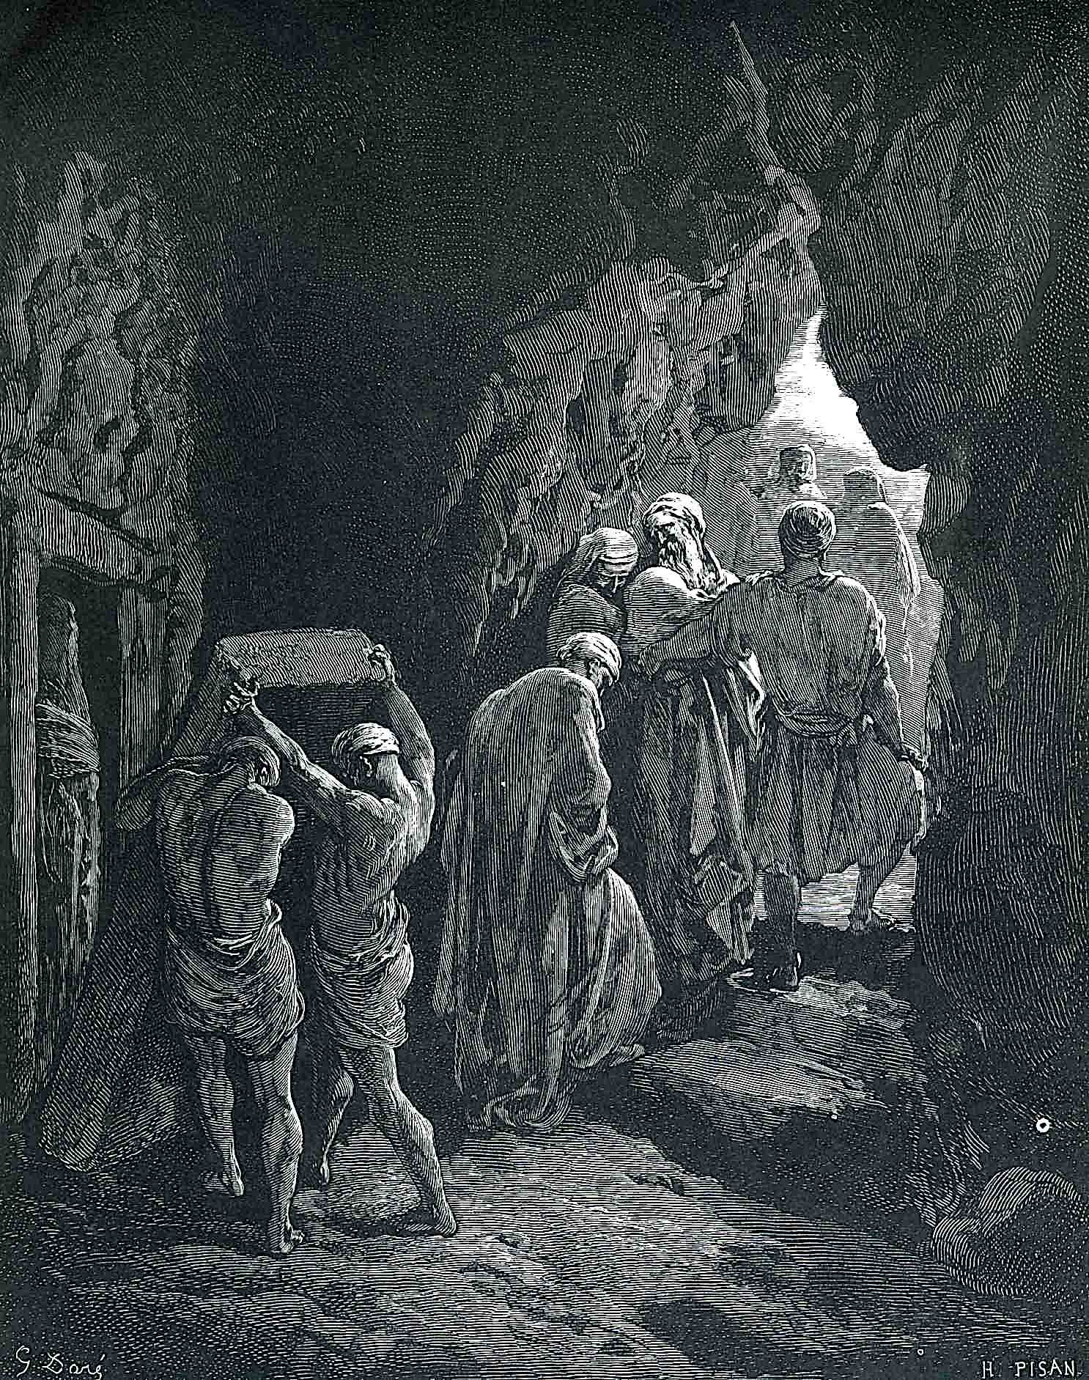
Genesis 23: 1-2, 25: 1, 5-9
23) ¹Sarah lived one hundred twenty-seven years. This was the length of Sarah’s life. ²Sarah died in Kiriath Arba (also called Hebron), in the land of Canaan. Abraham came to mourn for Sarah and to weep for her.
25) ¹Abraham took another wife and her name was Keturah... ⁵Abraham gave all that he had to Isaac, ⁶but Abraham gave gifts to the sons of Abraham’s concubines. While he still lived he sent them away from Isaac to the east country. ⁷These are the days of the years of Abraham’s life: one hundred seventy-five years. ⁸Abraham gave up his spirit and died at a good old age, and was gathered to his people. ⁹Isaac and Ishmael buried him in the cave of Machpelah, in the field of Ephron…

Slide 3
Questions
What passage of 23:2 implies that Abraham and Sarah might have separated?
Ishmael came to bury his father, even though he was sent away as a child and Abraham left “everything” to Isaac. What does this imply about Ishmael’s character?

Slide 4
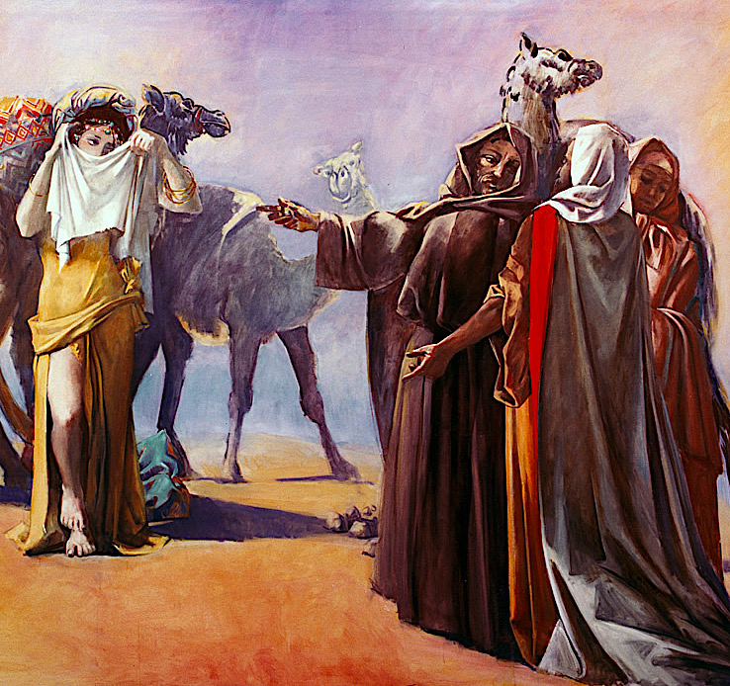
Genesis 25: 20-23
²⁰Isaac was forty years old when he took Rebekah, the sister of Laban the Syrian, to be his wife. ²¹Isaac prayed to Yahweh for his wife, because she was barren. Yahweh answered his prayers, and Rebekah his wife conceived. ²²The children struggled together within her. She said, “If it is like this why do I live?” She went to inquire of Yahweh. ²³Yahweh said to her,
“Two nations are in your womb. Two peoples will be separated from your body. The one people will be stronger than the other people. The elder will serve the younger.”

Slide 5
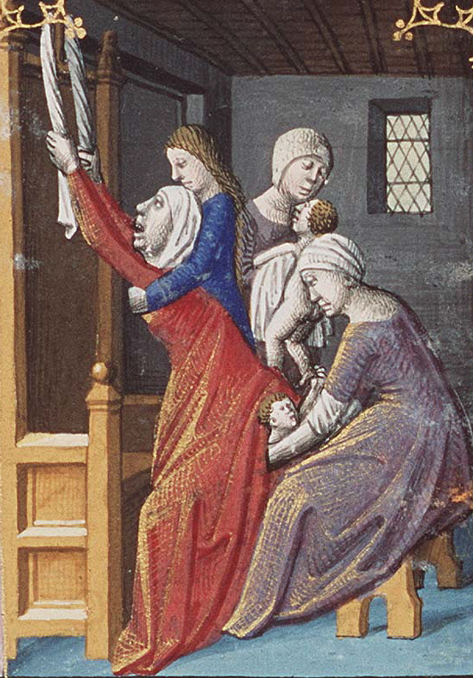
Genesis 25: 24-28
²⁴When her days to be delivered were fulfilled, behold, there were twins in her womb. ²⁵The first came out red all over, like a hairy garment. They named him Esau. ²⁶ After that, his brother came out and his hand had hold on Esau’s heel. He was named Jacob. Isaac was sixty years old when she bore them.
²⁷The boys grew. Esau was a skillful hunter, a man of the field. Jacob was a quiet man, living in tents. ²⁸Now Isaac loved Esau because he ate his venison. Rebekah loved Jacob.

Slide 6
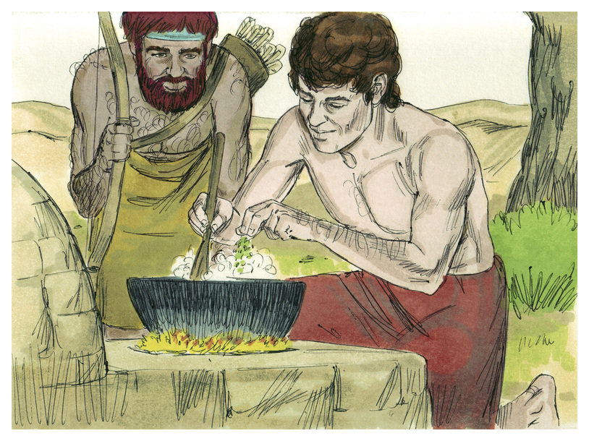
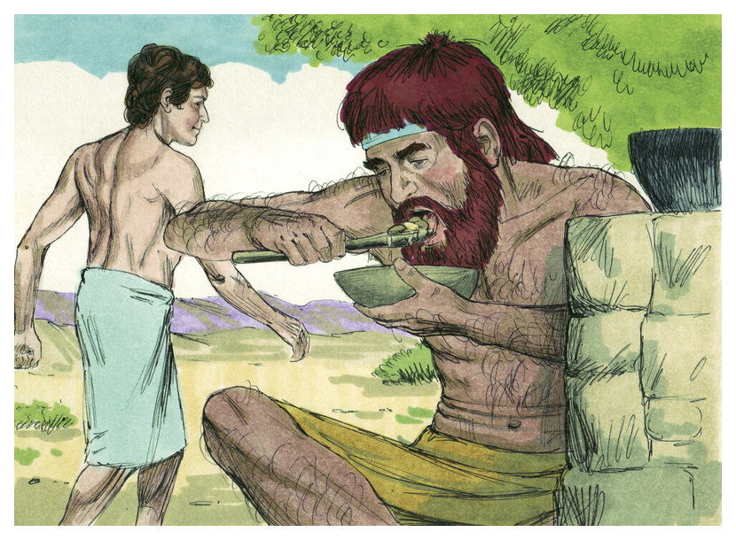
Genesis 25: 29-34
²⁹Jacob boiled stew. Esau came in from the field, and he was famished. ³⁰Esau said to Jacob, “Please feed me with some of that red stew for I am famished.” Therefore his name was called Edom.
³¹Jacob said, “First, sell me your birthright.”
³²Esau said, “Behold, I am about to die. What good is the birthright to me?”
³³Jacob said, “Swear to me first.”
He swore to him. He sold his birthright to Jacob. ³⁴Jacob gave Esau bread and lentil stew. He ate and drank, rose up, and went his way. So Esau despised his birthright.
Downloaded from FreeBibleimages.org

Slide 7
Questions
If you had to describe Esau in one word, what would it be?
If you had to describe Jacob in one word, what would it be?
What does “heel grabbing” signify?

Slide 8
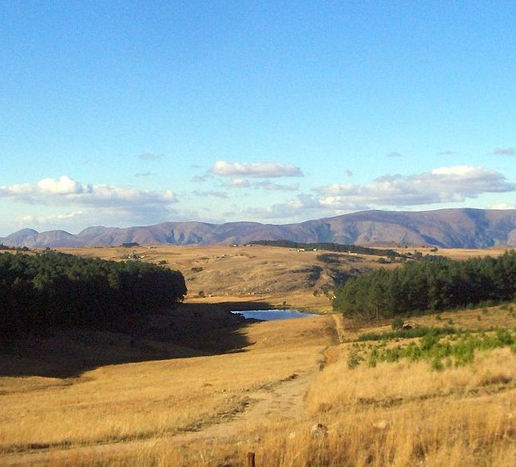
Genesis 26: 1-3
¹There was a famine in the land in addition to the first famine that was in the days of Abraham. Isaac went to Abimelech king of the Philistines to Gerar. ²Yahweh appeared to him and said, “Don’t go down into Egypt. Live in the land I will tell you about. ³Live in this land and I will be with you and will bless you. For I will give to you and to your offspring all these lands, and I will establish the oath which I swore to Abraham your father.

Slide 9
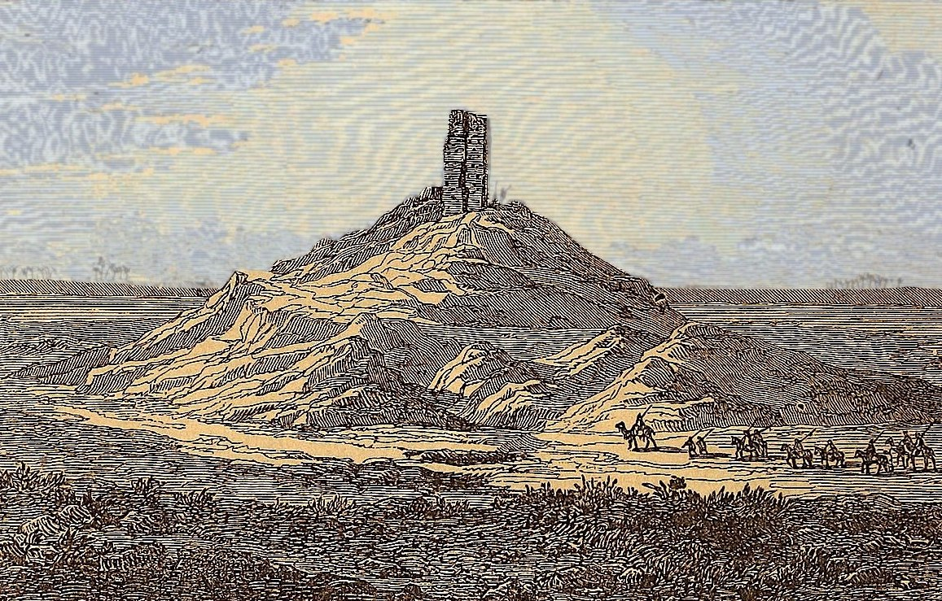
Genesis 26: 12-16
¹²Isaac sowed in that land and reaped in the same year one hundred times what he planted. Yahweh blessed him. ¹³The man grew great and grew more and more until he became very great. ¹⁴He had possessions of flocks, possessions of herds, and a great household. The Philistines envied him. ¹⁵Now all the wells which his father’s servants had dug in the days of Abraham his father, the Philistines had stopped and filled with earth. ¹⁶Abimelech said to Isaac “Go away from us, for you are much mightier than we.”

Slide 10
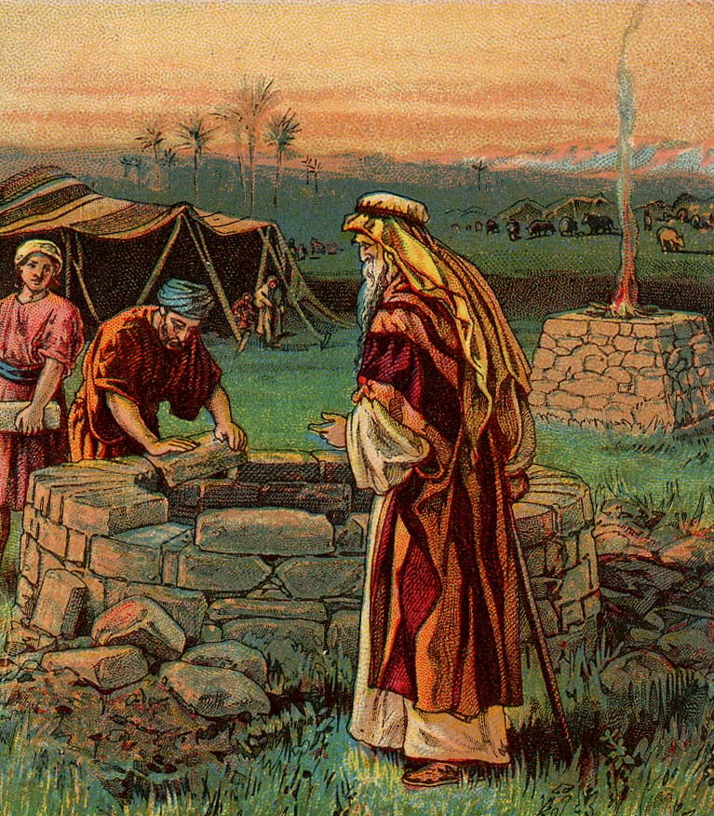
Genesis 26: 17, 19-22
¹⁷Isaac departed from there, encamped in the valley of Gerar and lived there... ¹⁹Isaac’s servants dug in the valley and found there a well of flowing water. ²⁰The herdsmen of Gerar argued with Isaac’s herdsmen saying, “The water is ours.” So he called the name of the well Esek, because they contended with him. ²¹They dug another well and they argued over that, also. So he called its name Sitnah. ²²He left that place and dug another well. They didn’t argue over that one. So he called it Rehoboth. He said, “For now Yahweh has made room for us and we will be fruitful in the land.”

Slide 11
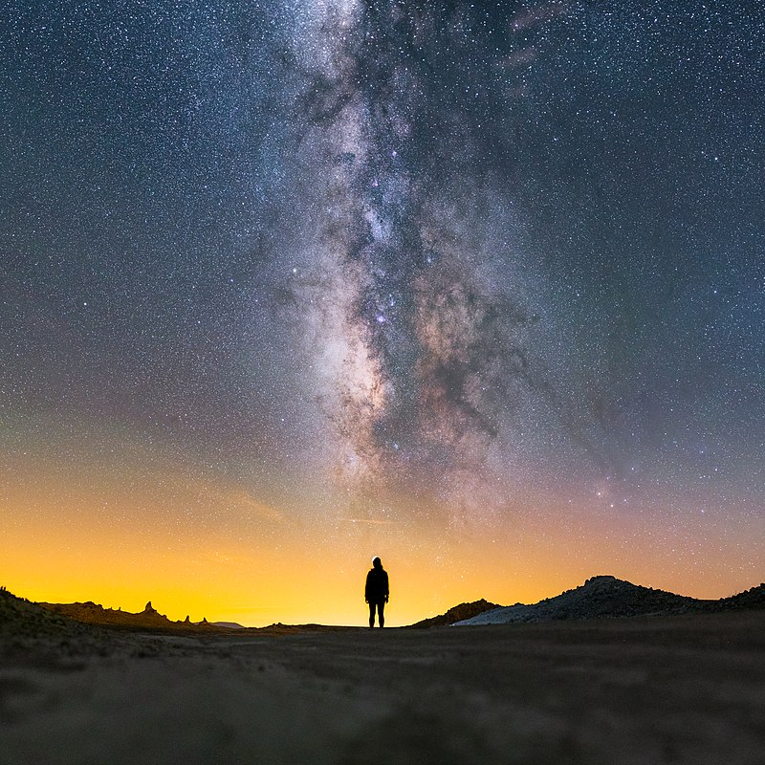
Genesis 26: 24-25
²⁴Yahweh appeared to him the same night and said, “I am the God of Abraham your father. Don’t be afraid, for I am with you and will bless you and multiply your offspring for my servant Abraham’s sake.”
²⁵He built an altar there and called on Yahweh’s name, and pitched his tent there. There Isaac’s servants dug a well.

Slide 12
Questions
The Philistines could have learned from Isaac how to dig wells but chose instead to fill them up. King Abimelek told Isaac to leave because he felt his success made him too “powerful”. Can you think of any modern examples of nations or societies that behaved this way towards people or groups that stood out for their success?

Slide 13
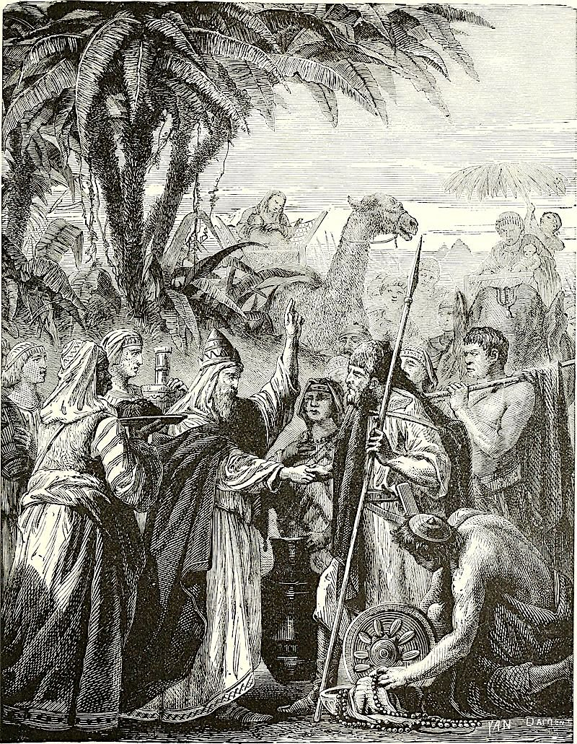
Genesis 26: 26-31, 34-35
²⁶Then Abimelech went to him from Gerar with Ahuzzath his friend, and Phicol the captain of his army. ²⁷Isaac said to them, “Why have you come to me since you hate me and have sent me away from you?”
²⁸They said, “We saw plainly that Yahweh was with you. We said, ‘Let there now be an oath between us, even between us and you and let’s make a covenant with you, ²⁹that you will do us no harm as we have not touched you and as we have done to you nothing but good and have sent you away in peace.’ You are now the blessed of Yahweh.”
³⁰He made them a feast, and they ate and drank. ³¹They rose up some time in the morning, and swore an oath to one another. Isaac sent them away, and they departed from him in peace.
³⁴When Esau was forty years old he took as wife Judith the daughter of Beeri the Hittite ... ³⁵This grieved Isaac’s and Rebekah’s spirits.

Slide 14
Questions
Why did King Amelek think it was necessary to visit Isaac?
Why would King Amelek regard Isaac as a threat to his power?
King Amelek told Isaac, “…we have done to you nothing but good, and have sent you away in peace.”. Is this accurate?
Why do you think King Amelek felt the need to rewrite history?
Esau married a Hittite. Why did his mother disapprove?
What other incident in Esau’s past behavior implies that he was not up to the task of maintaining God’s covenant?

Slide 15
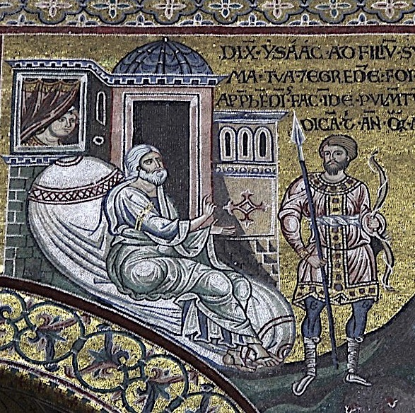
Genesis 27: 1-4
¹When Isaac was old and his eyes were dim so that he could not see, he called Esau his elder son, and said to him, “My son?”
He said to him, “Here I am.”
²He said, “See now, I am old. I don’t know the day of my death. ³Now therefore, please take your weapons, your quiver and your bow, and go out to the field and get me venison. ⁴Make me savory food such as I love and bring it to me that I may eat, and that my soul may bless you before I die.”

Slide 16
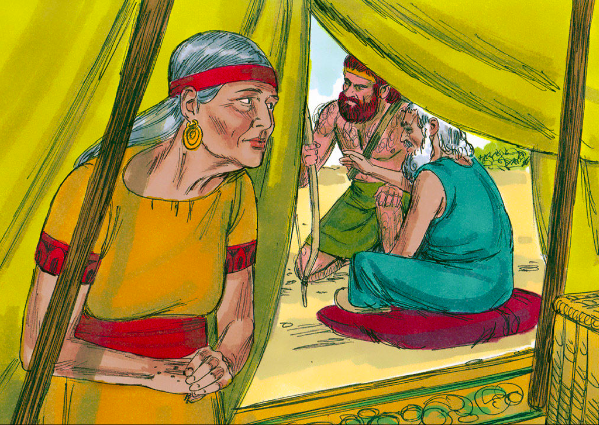
Genesis 27: 5-13
⁵Rebekah heard when Isaac spoke to Esau his son. Esau went to the field to hunt for venison and to bring it. ⁶Rebekah spoke to Jacob her son, saying, “Behold, I heard your father speak to Esau your brother, saying, ⁷‘Bring me venison and make me savory food that I may eat and bless you before Yahweh before my death.’ ⁸Now my son, ⁹Go now to the flock and get me two good young goats from there. I will make them savory food for your father such as he loves. ¹⁰You shall bring it to your father that he may eat, so that he may bless you before his death.”
Downloaded from FreeBibleimages.org
¹¹Jacob said to Rebekah his mother, “Behold, Esau my brother is a hairy man and I am a smooth man. ¹²What if my father touches me? I will seem to him as a deceiver and I would bring a curse on myself and not a blessing.”
¹³His mother said to him, “Let your curse be on me… Only obey my voice, and go get them for me.”

Slide 17
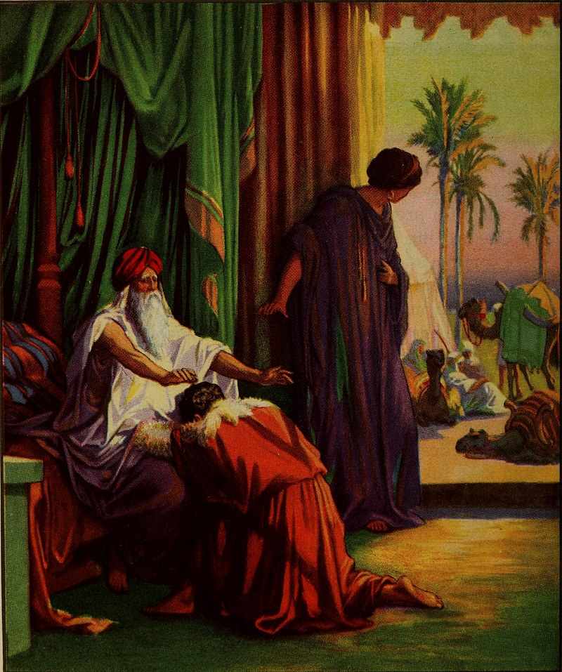
Genesis 27: 15-16, 25-29
¹⁵Rebekah took the good clothes of Esau which were with her in the house, and put them on Jacob. ¹⁶She put the skins of the young goats on his hands and on the smooth of his neck...
²⁵He said, “Bring it near to me, and I will eat of my son’s venison, that my soul may bless you.” He brought it near to him, and he ate. He brought him wine, and he drank. ²⁶His father Isaac said to him, “Come near now and kiss me my son.” ²⁷He came near, and kissed him. He smelled the smell of his clothing and blessed him and said,
“Behold, the smell of my son is as the smell of a field which Yahweh has blessed. ²⁸God give you of the dew of the sky of the fatness of the earth, and plenty of grain and new wine. ²⁹Let peoples serve you and nations bow down to you. Be lord over your brothers. Let your mother’s sons bow down to you. Cursed be everyone who curses you. Blessed be everyone who blesses you.”

Slide 18
Questions
Isaac was a decent man. Was it right for Rebekah to deceive him?
What did Rebekah mean when she said, “let your curse be on me.” What is the modern equivalent of this statement?
If Jacob was destined to maintain God’s covenant, why wasn’t he born first?
Why did God reveal His plan for the twins to Rebekah, but not to Isaac?

Slide 19
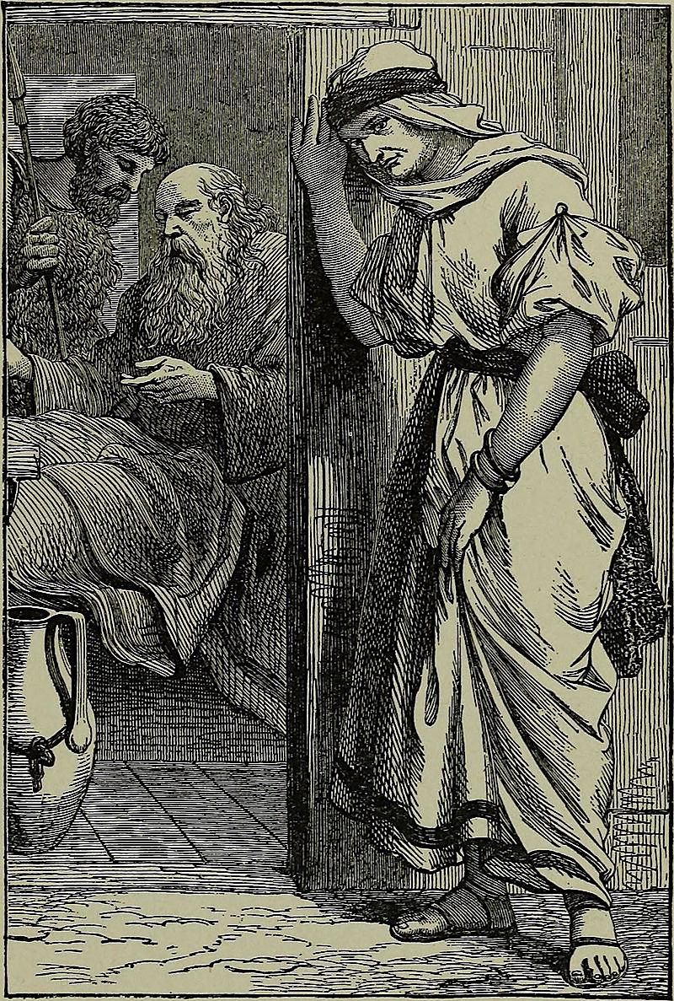
Genesis 27: 30-36
³⁰As soon as Isaac had finished blessing Jacob, and Jacob had just gone out from the presence of Isaac his father, Esau his brother came in from his hunting. ³¹He also made savory food and brought it to his father. He said to his father, “Let my father arise and eat of his son’s venison, that your soul may bless me.”
³²Isaac his father said to him, “Who are you?”
He said, “I am your son, your firstborn, Esau.”
³³Isaac trembled violently and said, “Who, then, is he who has taken venison and brought it to me, and I have eaten of all before you came and have blessed him? Yes, he will be blessed.”
³⁴When Esau heard the words of his father he cried with an exceedingly great and bitter cry, and said to his father, “Bless me, even me also, my father.”
³⁵He said, “Your brother came with deceit and has taken away your blessing.”
³⁶He said, “Isn’t he rightly named Jacob? For he has supplanted me these two times. He took away my birthright. See, now he has taken away my blessing.” He said, “Haven’t you reserved a blessing for me?”

Slide 20
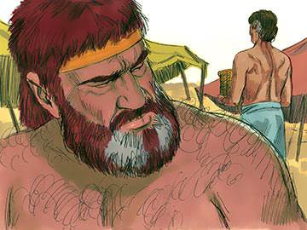
Genesis 27: 37-41
³⁷Isaac answered Esau, “Behold, I have made him your lord, and all his brothers I have given to him for servants. I have sustained him with grain and new wine. What then will I do for you, my son?”
³⁸Esau said to his father, “Do you have just one blessing, my father?” Esau lifted up his voice, and wept.
Downloaded from FreeBibleimages.org
³⁹Isaac his father answered him, “Behold, your dwelling will be of the fatness of the earth and of the dew of the sky from above. ⁴⁰You will live by your sword and you will serve your brother. It will happen when you will break loose, that you will shake his yoke from off your neck.”
⁴¹Esau hated Jacob because of the blessing with which his father blessed him. Esau said in his heart, “The days of mourning for my father are at hand. Then I will kill my brother Jacob.”

Slide 21
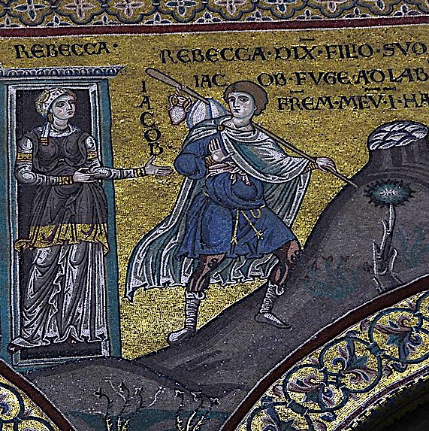
Genesis 27: 42-46, 28: 1-4
27) ⁴²The words of Esau, her elder son, were told to Rebekah. She sent and called Jacob and said to him, “Behold, your brother Esau comforts himself about you by planning to kill you. ⁴³Now therefore, my son. Arise and flee to Laban, my brother, in Haran. ⁴⁴Stay with him a few days until your brother’s fury turns away— ⁴⁵and he forgets what you have done to him. Then I will send, and get you from there. Why should I be bereaved of you both in one day?”
⁴⁶Rebekah said to Isaac, “I am weary of my life because of the daughters of Heth. If Jacob takes a wife of the daughters of Heth such as these, what good will my life do me?”
28) ¹Isaac called Jacob, blessed him, and commanded him, “You shall not take a wife of the daughters of Canaan. ²Arise, go to Paddan Aram, to the house of Bethuel your mother’s father. Take a wife from there from the daughters of Laban, your mother’s brother. ³May God Almighty bless you and make you fruitful and multiply you, that you may be a company of peoples, ⁴and give you the blessing of Abraham to you and to your offspring with you, that you may inherit the land where you travel which God gave to Abraham.”

Slide 22
Questions
Did Isaac really have the power to bless the lives of his sons? If not, what was the meaning of this gesture?
Why did Rebekah suddenly express a concern that Jacob would marry a Hittite?
Why did Isaac bless Jacob a second time, even after he knew had been deceived?

Slide 23
Acknowledgments:
Scripture verses were taken from the World English Bible and edited for clarity.
Unless otherwise indicated, all images were downloaded from Wikimedia.
Most of the questions are derived from commentary from “The Rational Bible: Genesis” by Dennis Prager.

