Slide 1
Lesson plans for Genesis 32-35
Antonio Chaves

Slide 2
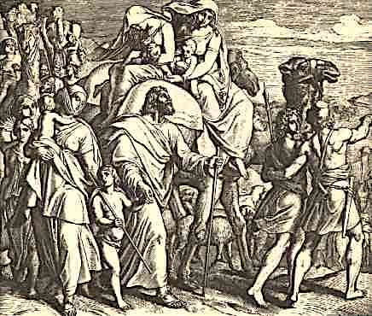
Genesis 32: 3-8
³Jacob sent messengers in front of him to Esau, his brother, to the land of Seir, the field of Edom. ⁴He commanded them, saying, “This is what you shall tell my lord Esau: ‘This is what your servant, Jacob, says. I have lived as a foreigner with Laban, and stayed until now. ⁵I have cattle, donkeys, flocks, male servants, and female servants. I have sent to tell my lord that I may find favor in your sight.’”
⁶The messengers returned to Jacob saying, “We came to your brother Esau. He is coming to meet you and four hundred men are with him.” ⁷Then Jacob was greatly afraid and was distressed. He divided the people who were with him along with the flocks, the herds, and the camels, into two companies. ⁸He said, “If Esau comes to the one company and strikes it, then the company which is left will escape.”

Slide 3
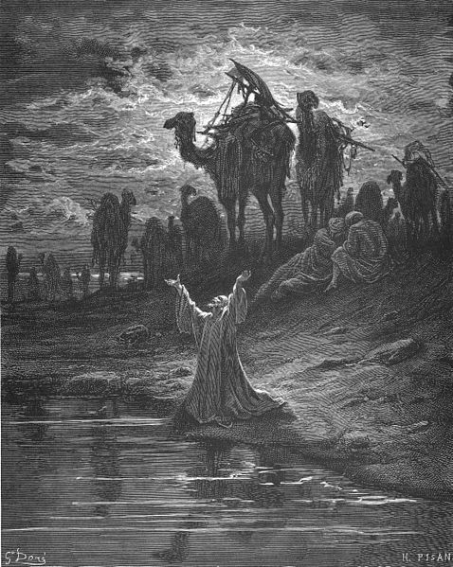
Genesis 32: 9-12
⁹Jacob said, “God of my father Abraham, and God of my father Isaac, Yahweh, who said to me, ‘Return to your country and to your relatives and I will do you good,’ ¹⁰I am not worthy of the least of all the loving kindnesses and of all the truth which you have shown to your servant; for with just my staff I crossed over this Jordan; and now I have become two companies. ¹¹Please deliver me from the hand of my brother, from the hand of Esau; for I fear him, lest he come and strike me and the mothers with the children. ¹²You said, ‘I will surely do you good and make your offspring as the sand of the sea, which can’t be counted because there are so many.’”

Slide 4
Questions
What led Jacob to believe he was in danger?
Compare Jacobs prayer for protection to his prayer three chapters earlier (following his dream). How are they different?
How had Jacob’s relationship with God changed since the time he started his journey?

Slide 5
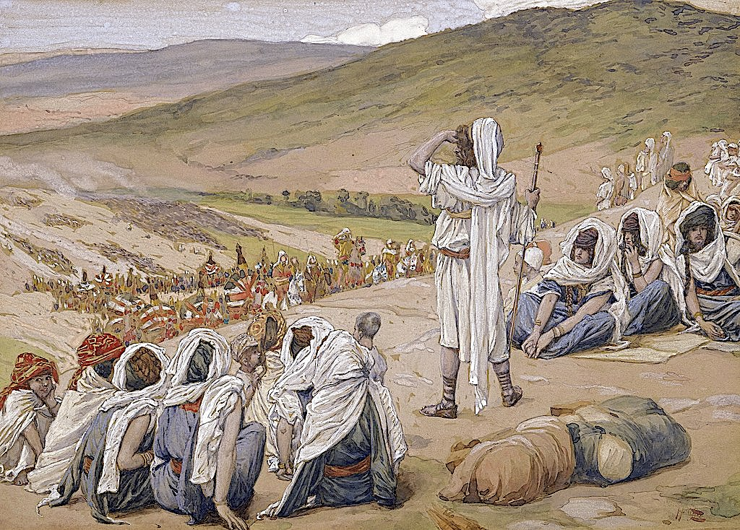
Genesis 32: 13-18, 22-23
¹³He stayed there that night and took from that which he had with him a present for Esau: ¹⁴two hundred female goats and twenty male goats, two hundred ewes and twenty rams, ¹⁵thirty milk camels and their colts, forty cows, ten bulls, twenty female donkeys and ten foals. ¹⁶He delivered them into the hands of his servants, every herd by itself, and said to his servants, “Pass over before me, and put a space between herd and herd.” ¹⁷He commanded the foremost, saying, “When Esau, my brother, meets you, …¹⁸Then you shall say, ‘They are your servant, Jacob’s. It is a present sent to my lord, Esau. Behold, he also is behind us.’”… ²²That night Jacob got up and took his two wives, his two female servants and his eleven sons and crossed the ford of the Jabbok. ²³After he had sent them across he sent over his possessions.

Slide 6
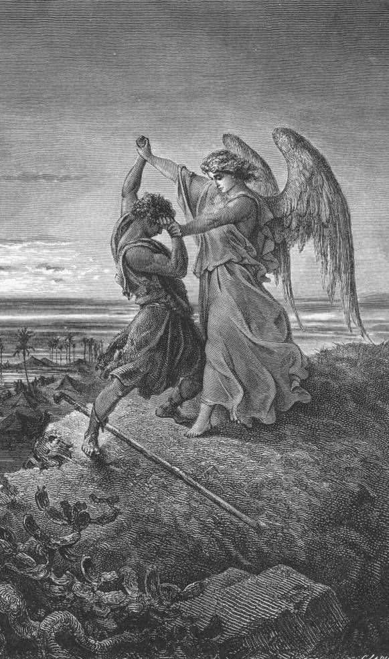
Genesis 32: 24-28
²⁴Jacob was left alone and wrestled with a man there until the breaking of the day. ²⁵When he saw that he didn’t prevail against him, the man touched the hollow of his thigh and the hollow of Jacob’s thigh was strained as he wrestled. ²⁶The man said, “Let me go, for the day breaks.”
Jacob said, “I won’t let you go unless you bless me.”
²⁷He said to him, “What is your name?”
He said, “Jacob”.
²⁸He said, “Your name will no longer be called Jacob but Israel; for you have fought with God and with men, and have prevailed.”

Slide 7
Questions
What does it mean to “struggle” with God? How does this set Christianity and Judaism apart from other faiths?
Can you provide a different example of a prophet from Genesis “struggling” with God?
What are the hazards of never struggling with your faith?

Slide 8
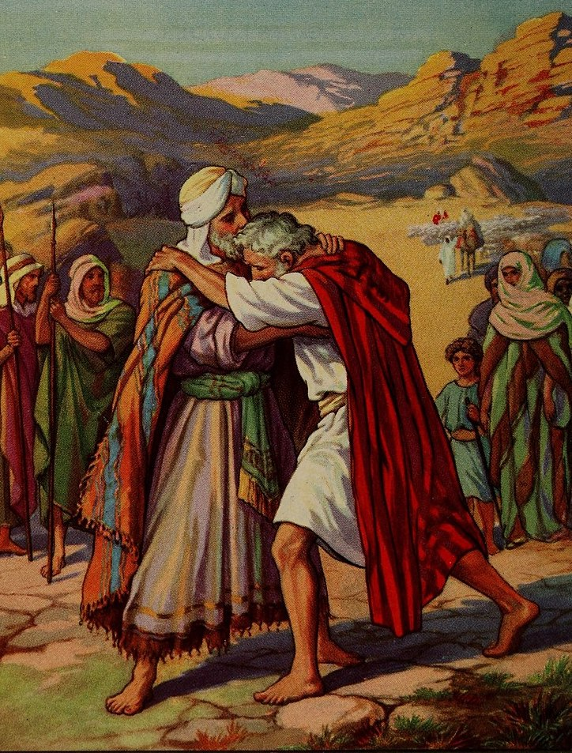
Genesis 33: 1-4, 8-10
¹Jacob lifted up his eyes and and behold, Esau was coming, and with him four hundred men. He divided the children between Leah, Rachel, and the two servants. ²He put the servants and their children in front, Leah and her children after, and Rachel and Joseph at the rear. ³He himself passed over in front of them and bowed himself to the ground seven times until he came near to his brother. ⁴Esau ran to meet him, embraced him, fell on his neck, kissed him, and they wept…
⁸Esau said, “What do you mean by all this company which I met?”
Jacob said, “To find favor in the sight of my lord.”
⁹Esau said, “I have enough, my brother; let that which you have be yours.”
¹⁰Jacob said, “Please, no, if I have now found favor in your sight, then receive my present at my hand, because I have seen your face as one sees the face of God, and you were pleased with me.”

Slide 9
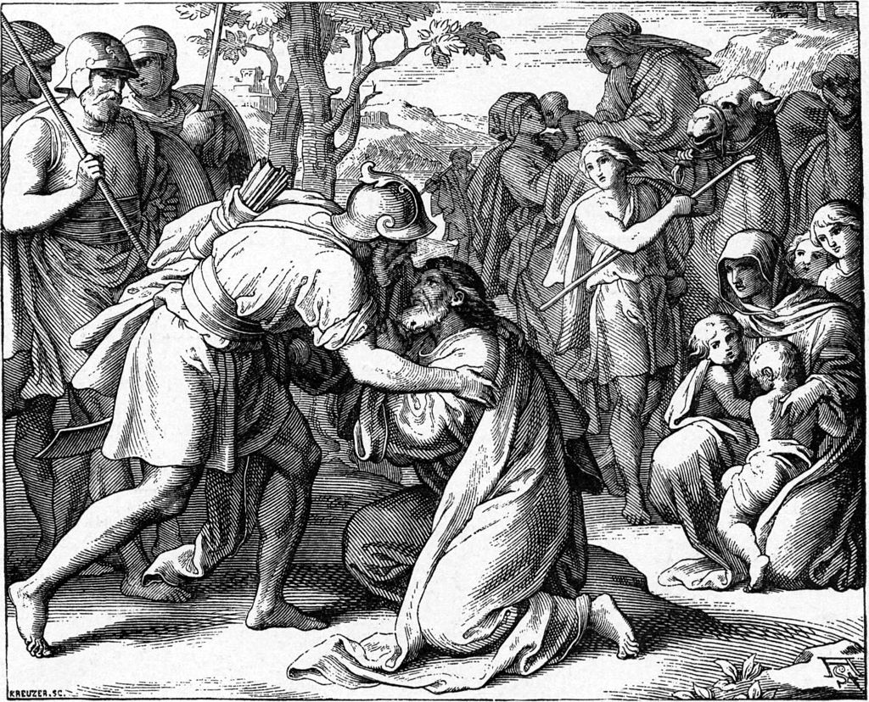
Genesis 33: 11, 15-17
¹¹Please take the gift that I brought to you because God has dealt graciously with me, and because I have enough.” He urged him and he took it…
¹⁵Esau said, “Let me now leave with you some of the people who are with me.”
He said, “Why? Let me find favor in the sight of my lord.”
¹⁶So Esau returned that day on his way to Seir. ¹⁷Jacob traveled to Succoth, built himself a house and made shelters for his livestock. Therefore the name of the place is called Succoth.

Slide 10
Questions
What is Esau’s reaction after meeting Jacob?
Why did Jacob say to Esau, “For me to see your face is like seeing the face of God”? Is he comparing Esau to God or does he mean something completely different?
Why did Jacob and Esau go their separate ways?

Slide 11
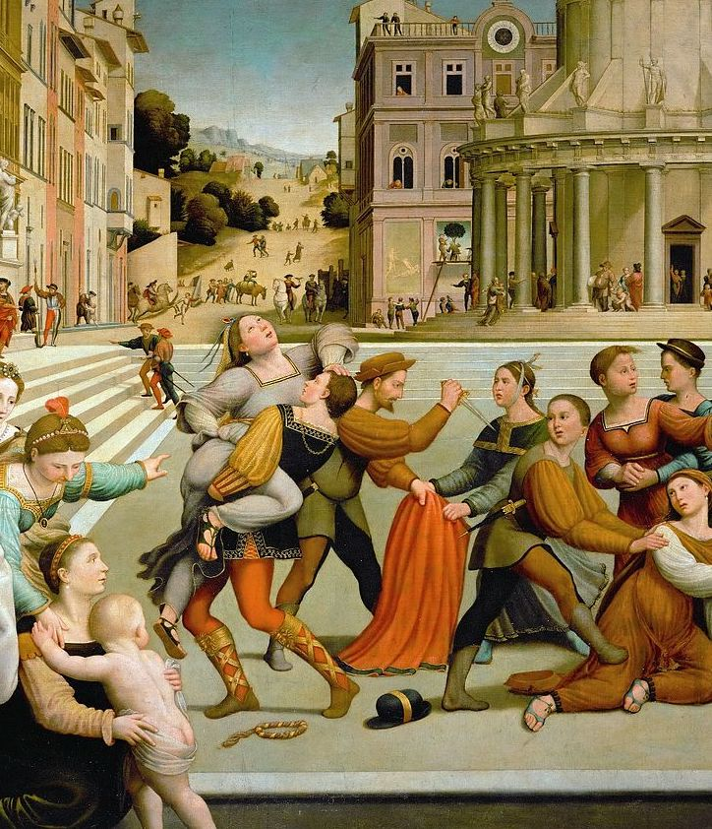
Genesis 34: 1-12
¹Dinah, the daughter of Leah, went out to see the daughters of the land. ²Shechem the son of Hamor the Hivite and prince of the land, took her and raped her. ³He loved the young lady and spoke kindly to her. ⁴Shechem spoke to his father saying, “Get me this young lady as a wife.”
⁵Now Jacob heard that he had defiled Dinah, and his sons were in the field. Jacob held his peace until they came. ⁶Hamor the father of Shechem went out to Jacob to talk with him. ⁷The sons of Jacob came when they heard it. They were very angry because Shechem had done with Jacob’s daughter, a thing that ought not to be done.
⁸Hamor talked with them, saying, “The soul of my son, Shechem, longs for your daughter. Please give her to him as a wife. ⁹Give your daughters to us, and take our daughters for yourselves. ¹⁰You shall dwell with us, and the land will be before you.”
¹¹Shechem said to her father and to her brothers, “Let me find favor in your eyes, and whatever you will tell me I will give. ¹²Ask me a great amount for a dowry, but give me the young lady as a wife.”

Slide 12
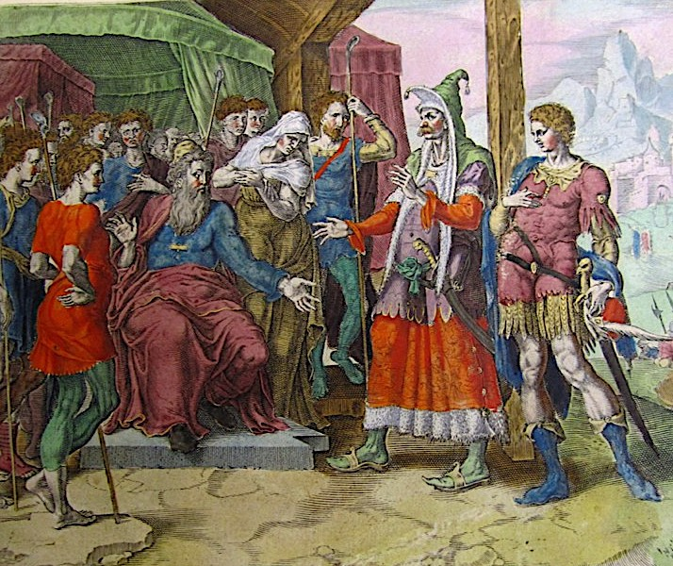
Genesis 34: 13-24
¹³The sons of Jacob answered Shechem and Hamor with deceit when they spoke, because he had defiled their sister ¹⁴and said, “We can’t do this thing to give our sister to one who is uncircumcised. ¹⁵Only on this condition will we consent to you. If you will be as we are, that every male of you be circumcised, ¹⁶then will we give our daughters to you,and we will dwell with you and we will become one people. ¹⁷But if you will not listen to us and be circumcised, then we will take our sister, and be gone.”
¹⁸Their words pleased Hamor and Shechem, Hamor’s son. ¹⁹The young man didn’t wait to do this thing because he had delight in Jacob’s daughter and he was honored above all the house of his father. ²⁰Hamor and Shechem came to the gate of their city and talked with the men of their city saying, ²¹“These men are peaceful with us. Therefore let them live in the land and trade in it. For the land is large enough for them. Let’s take their daughters and let’s give them our daughters. ²²Only on this condition will the men consent to us to live with us if every male among us is circumcised as they are. ²³Won’t their livestock and their possessions and all their animals be ours? Only let’s give our consent and they will dwell with us.” ²⁴All who went out of the gate of his city listened to them and every male was circumcised.

Slide 13
Questions
When Hamar approached Jacob he said, “My son Shechem longs for your daughter. Please give her to him as his wife.” What is missing in this statement? What is morally questionable about this exchange?
What does this statement reveal about Hamar and Shechem’s worldviews?

Slide 14
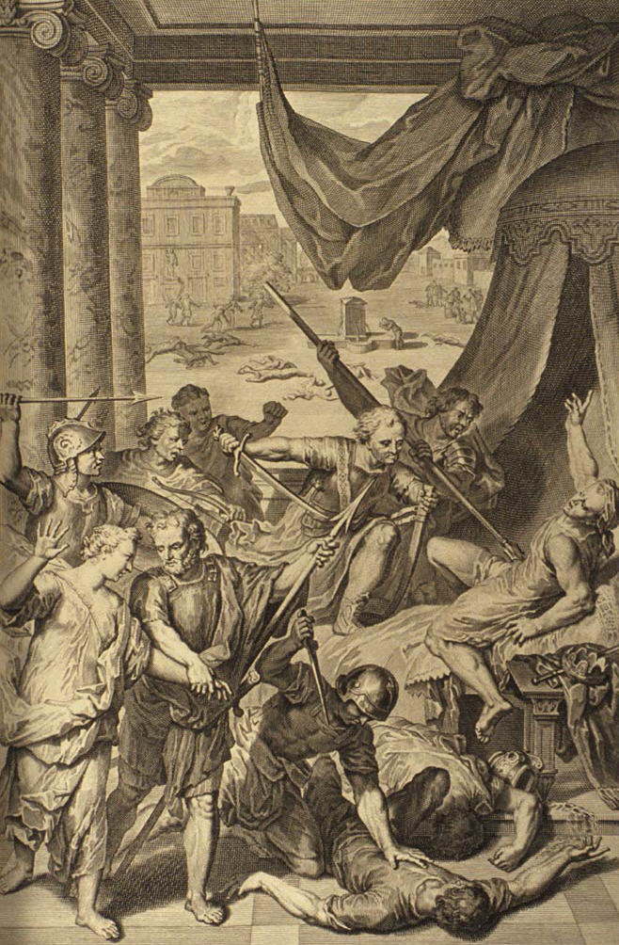
Genesis 34: 25-31
²⁵On the third day, when they were sore, two of Jacob’s sons, Simeon and Levi, Dinah’s brothers, each took his sword and killed all the males. ²⁶They killed Hamor and Shechem, took Dinah, and went away. ²⁷Jacob’s sons then plundered the city. ²⁸They took their flocks, their herds, their donkeys, in the city and in the field, ²⁹and all their wealth. They took captive all their children and their wives, and took as plunder everything that was in the house. ³⁰Jacob said to Simeon and Levi, “You have troubled me, to make me odious to the inhabitants of the land, among the Canaanites and the Perizzites. I am few in number. They will gather themselves together against me and strike me, and we will be destroyed.”
³¹They said, “Should he deal with our sister as with a prostitute?”

Slide 15
Questions
Jacob responded to the massacre by telling his sons, “You trouble on me by making me odious to the people living in this land.” What is missing in Jacob’s criticism?
In Genesis 49: 5-6 Jacob said, “Simeon and Levi are brothers. Their swords are weapons of violence. My soul, don’t come into their council. My glory, don’t be united to their assembly; for in their anger they killed men. In their self-will they hamstrung cattle.” How is this different from his original criticism of the massacre?

Slide 16
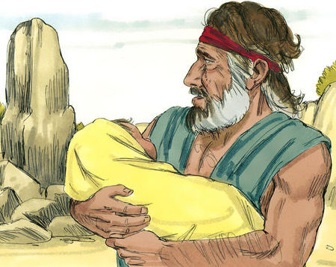
Genesis 35: 16-22
¹⁶They traveled from Bethel. There was still some distance to come to Ephrath, and Rachel travailed. She was in labor. ¹⁷ When she was in hard labor, the midwife said to her, “Don’t be afraid, for now you will have another son.”
¹⁸As her soul was departing she named him Benoni, but his father named him Benjamin. ¹⁹Rachel died, and was buried on the way to Ephrath (also called Bethlehem). ²⁰Jacob set up a pillar on her grave. The same is the Pillar of Rachel’s grave to this day.
Downloaded from FreeBibleimages.org
²¹Israel traveled, and spread his tent beyond the tower of Eder. ²²While Israel lived in that land, Reuben went and lay with Bilhah, his father’s concubine, and Israel heard of it.

Slide 17
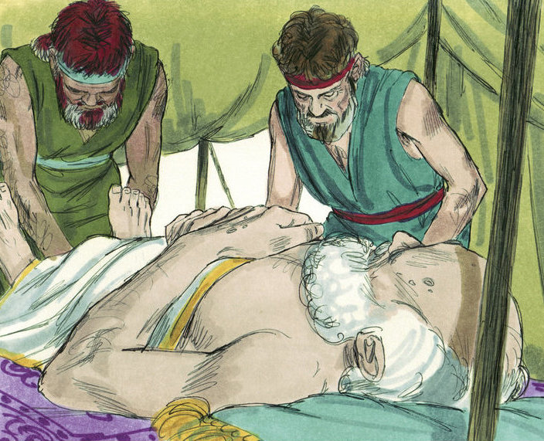
Genesis 35: 27-29
²⁷Jacob came to Isaac his father, to Mamre, to Kiriath Arba (which is Hebron), where Abraham and Isaac lived as foreigners.
²⁸The days of Isaac were one hundred eighty years. ²⁹Isaac gave up the spirit and died, and was gathered to his people old and full of days. Esau and Jacob buried him.
Downloaded from FreeBibleimages.org

Slide 18
Questions
Rachel had two sons. What are their names?
Reuben was Leah’s first son and Bilhah was Rachel’s servant. Why do you think that Reuben slept with Bilhah while Jacob was away?
The term “gathered to his people” was also used when Abraham passed away. What does it mean?

Slide 19
Acknowledgments:
Scripture verses were taken from the World English Bible and edited for clarity.
Unless otherwise indicated, all images were downloaded from Wikimedia.
Most of the questions are derived from commentary from “The Rational Bible: Genesis” by Dennis Prager.

