Slide 1
Lesson plans for Genesis 37- 41
Antonio Chaves

Slide 2
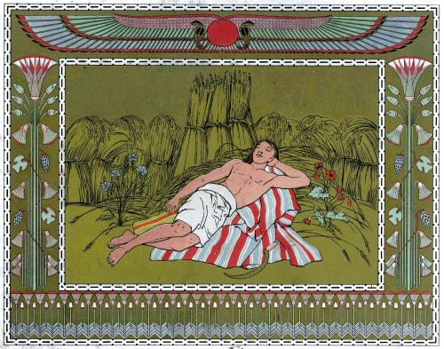
Genesis 37: 3-8
³Now Israel loved Joseph more than all his children because he was the son of his old age and he made him a tunic of many colors. ⁴His brothers saw that their father loved him more than all his brothers and they hated him and couldn’t speak peaceably to him.
⁵Joseph dreamed a dream, and he told it to his brothers, and they hated him all the more. ⁶He said to them, “Please hear this dream which I have dreamed: ⁷for behold, we were binding sheaves in the field and behold, my sheaf arose and also stood upright; and behold, your sheaves came around and bowed down to my sheaf.”
⁸His brothers asked him, “Will you indeed reign over us? Will you indeed have dominion over us?” They hated him all the more for his dreams and for his words.

Slide 3
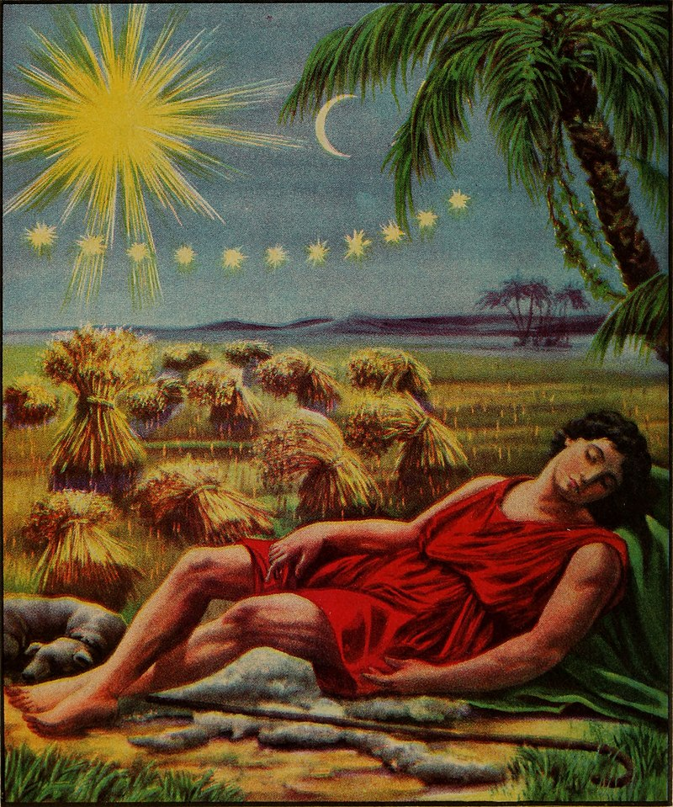
Genesis 37: 9-11
⁹He dreamed yet another dream and told it to his brothers and said, “Behold, I have dreamed yet another dream: and behold, the sun and the moon and eleven stars bowed down to me.” ¹⁰He told it to his father and to his brothers. His father rebuked him, and said to him, “What is this dream that you have dreamed? Will I and your mother and your brothers indeed come to bow ourselves down to the earth before you?” ¹¹His brothers envied him but his father kept this account in mind.

Slide 4
Questions
How was Jacob at fault in how he treated his sons?
Why do you think that Joseph was his favorite son?
Why did Jacob reprimand Joseph? How was Joseph at fault?

Slide 5
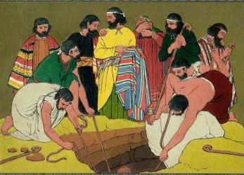
Genesis 37: 12-13, 17-24
¹²His brothers went to feed their father’s flock in Shechem. ¹³ Israel said to Joseph, “Aren’t your brothers feeding the flock in Shechem? Come and I will send you to them.” He said to him, “Here I am.”
¹⁷The man said, “They have left here, for I heard them say, ‘Let’s go to Dothan.’”
Joseph went after his brothers and found them in Dothan. ¹⁸They saw him afar off and before he came near to them they conspired against him to kill him.
¹⁹They said to one another, “Behold, this dreamer comes. ²⁰Come now therefore and let’s kill him and cast him into one of the pits and we will say, ‘An evil animal has devoured him.’ We will see what will become of his dreams.”
²¹Reuben heard it and delivered him out of their hand, and said “Let’s not take his life.” ²²Reuben said to them, “Shed no blood. Throw him into this pit that is in the wilderness but lay no hand on him”—that he might deliver him out of their hand, to restore him to his father. ²³When Joseph came to his brothers, they stripped Joseph of the tunic of many colors that was on him ²⁴and they took him and threw him into the pit. The pit was empty. There was no water in it.

Slide 6
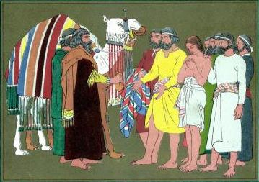
Genesis 37: 25-29
²⁵They sat down to eat bread and they lifted up their eyes and looked and saw a caravan of Ishmaelites was coming from Gilead, with their camels bearing spices and balm and myrrh, going to carry it down to Egypt. ²⁶Judah said to his brothers, “What profit is it if we kill our brother and conceal his blood? ²⁷Come, and let’s sell him to the Ishmaelites, and not let our hand be on him; for he is our brother, our flesh.” His brothers listened to him.
²⁸Midianites who were merchants passed by and they drew and lifted up Joseph out of the pit, and sold Joseph to the Ishmaelites for twenty pieces of silver. The merchants brought Joseph into Egypt.
²⁹Reuben returned to the pit, and saw that Joseph wasn’t in the pit; and he tore his clothes.

Slide 7
Questions
Which brother tried to thwart the plot?
After they threw Joseph into the cistern the brothers sat down to a meal. How do you think they felt about what they did?
Did Judah propose selling Judah only for the money?

Slide 8
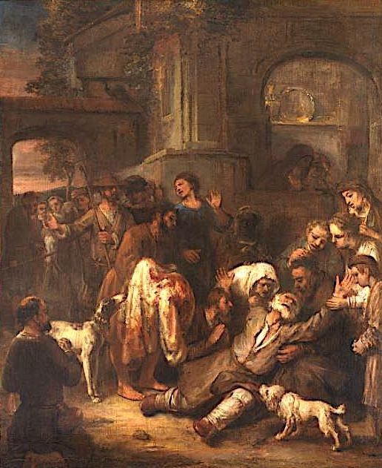
Genesis 37: 31-36
³¹They took Joseph’s tunic and killed a male goat and dipped the tunic in the blood. ³²They took the tunic of many colors, and they brought it to their father and said, “We have found this. Examine it now and see if it is your son’s tunic or not.”
³³He recognized it and said, “It is my son’s tunic. An evil animal has devoured him. Joseph is without doubt torn in pieces.” ³⁴ Jacob tore his clothes, and put sackcloth on his waist and mourned for his son many days. ³⁵All his sons and all his daughters rose up to comfort him, but he refused to be comforted. He said, “For I will go down to Sheol to my son, mourning.” His father wept for him.
³⁶The Midianites sold him into Egypt to Potiphar, an officer of Pharaoh’s, the captain of the guard.

Slide 9
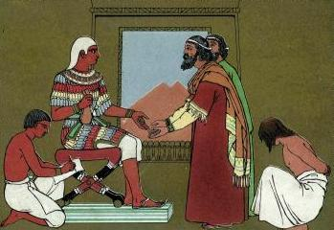
Genesis 39: 2-5
²Yahweh was with Joseph, and he was a prosperous man. He was in the house of his master the Egyptian. ³His master saw that Yahweh was with him, and that Yahweh made all that he did prosper in his hand. ⁴Joseph found favor in his sight. He ministered to him and Potiphar made him overseer over his house and all that he had he put into his hand. ⁵From the time that he made him overseer in his house and over all that he had, Yahweh blessed the Egyptian’s house for Joseph’s sake. Yahweh’s blessing was on all that he had in the house and in the field.

Slide 10
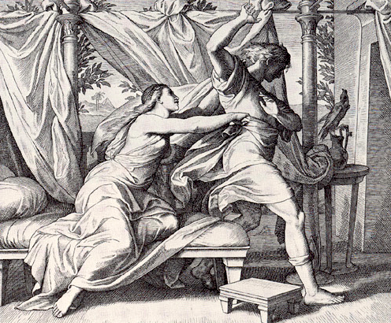
Genesis 39: 6-12
⁶He left all that he had in Joseph’s hand. He didn’t concern himself with anything, except for the food which he ate.
Joseph was well-built and handsome. ⁷After these things his master’s wife set her eyes on Joseph; and she said, “Lie with me.”
⁸But he refused and said to his master’s wife, “Behold, my master doesn’t know what is with me in the house, and he has put all that he has into my hand. ⁹No one is greater in this house than I am and he has not kept back anything from me but you because you are his wife. How then can I do this great wickedness, and sin against God?”
¹⁰As she spoke to Joseph day by day he didn’t listen to her to lie by her, or to be with her. ¹¹About this time he went into the house to do his work, and there were none of the men of the house inside. ¹²She caught him by his garment saying, “Lie with me!”

Slide 11
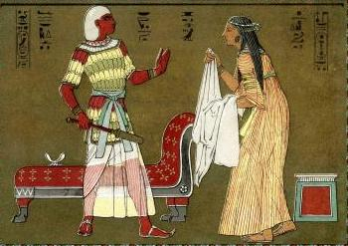
Genesis 39: 13-19
¹³When she saw that he had left his garment in her hand and had run outside, ¹⁴she called to the men of her house and spoke to them, saying, “Behold, he has brought a Hebrew in to us to mock us. He came in to me to lie with me, and I cried with a loud voice. ¹⁵When he heard that I lifted up my voice and cried, he left his garment by me and ran outside.
¹⁶She laid up his garment by her until his master came home. ¹⁷She spoke to him according to these words, saying, “The Hebrew servant, whom you have brought to us, came in to me to mock me, ¹⁸and as I lifted up my voice and cried, he left his garment by me, and ran outside.”
¹⁹When his master heard the words of his wife which she spoke to him, saying, “This is what your servant did to me,” his wrath was kindled.

Slide 12
Genesis 39: 20-23
²⁰Joseph’s master took him and put him into the prison, the place where the king’s prisoners were bound, and he was there in custody. ²¹But Yahweh was with Joseph and showed kindness to him, and gave him favor in the sight of the keeper of the prison. ²²The keeper of the prison committed to Joseph’s hand all the prisoners who were in the prison. Whatever they did there he was responsible for it. ²³The keeper of the prison didn’t look after anything that was under his hand because Yahweh was with him; and that which he did Yahweh made it prosper.

Slide 13
Questions
Why did Potiphar put Joseph in charge of everything?
In the ancient world, husbands almost always put to death anyone suspected of seducing their wives. Why did Joseph get off so easy?
Do you think Potiphar’s anger was directed only at Joseph?

Slide 14
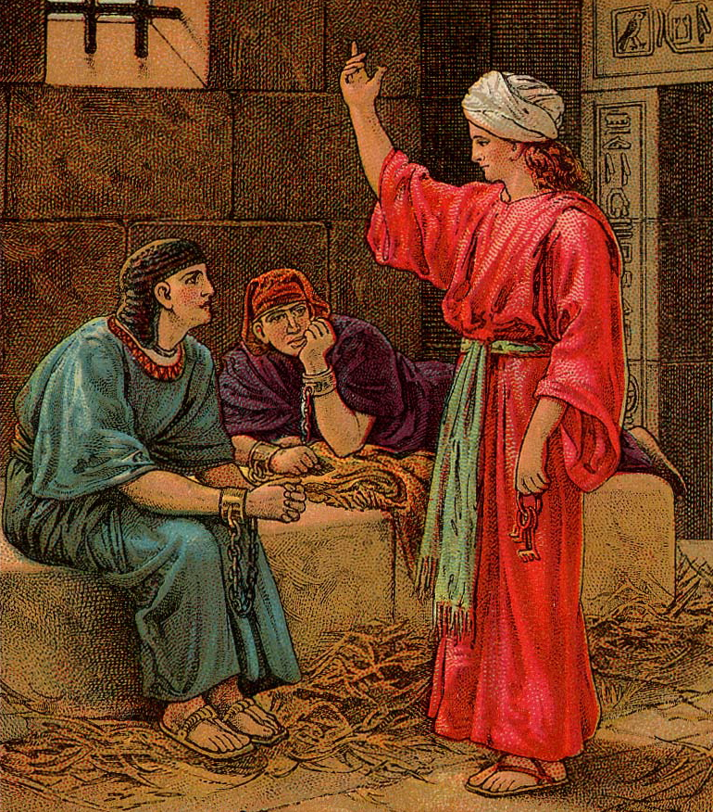
Genesis 40: 1-7
¹After these things the butler of the king of Egypt and his baker offended the king. ²Pharaoh was angry with his two officers, the chief cup bearer and the chief baker. ³He put them in custody in the house of the captain of the guard, into the prison, the place where Joseph was bound. ⁴The captain of the guard assigned them to Joseph and he took care of them. They stayed in prison many days. ⁵They both dreamed a dream… ⁶Joseph came in to them in the morning and saw them and saw that they were sad. ⁷He asked Pharaoh’s officers who were with him in custody in his master’s house, saying, “Why do you look so sad today?

Slide 15
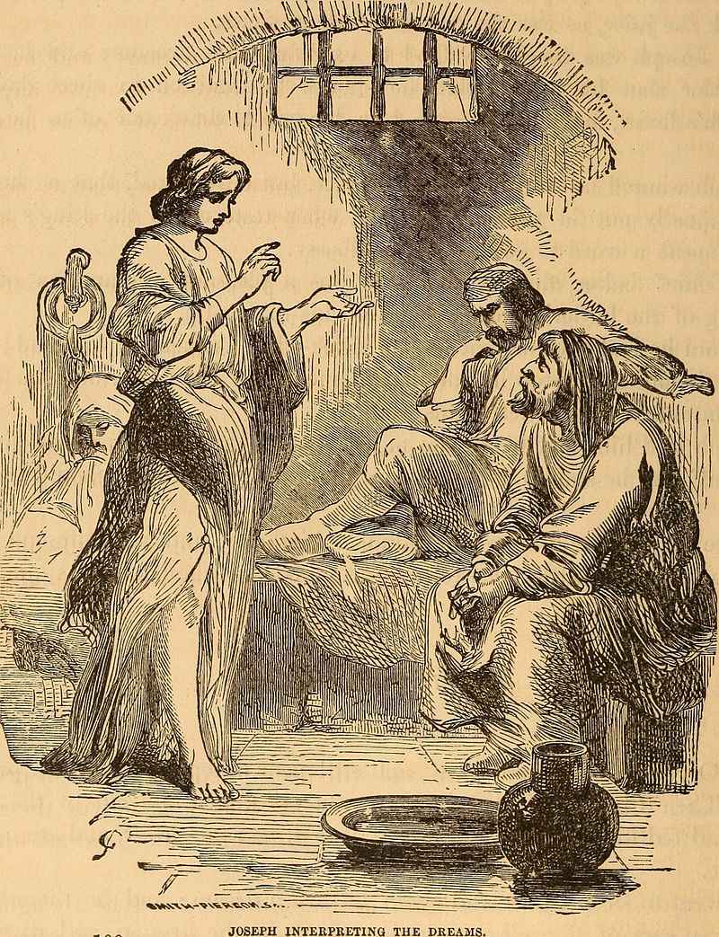
Genesis 40: 8-15
⁸They said to him, “We have dreamed a dream, and there is no one who can interpret it.”
Joseph said to them, “Don’t interpretations belong to God? Please tell it to me.”
⁹The chief cup bearer told his dream to Joseph, and said to him, “In my dream, behold, a vine was in front of me, ¹⁰and in the vine were three branches. It blossomed and its clusters produced ripe grapes. ¹¹Pharaoh’s cup was in my hand; and I took the grapes, and pressed them into Pharaoh’s cup, and I gave the cup into Pharaoh’s hand.”
¹²Joseph said to him, “This is its interpretation: the three branches are three days. ¹³Within three more days, Pharaoh will lift up your head, and restore you to your office. You will give Pharaoh’s cup into his hand, the way you did when you were his cup bearer. ¹⁴But remember me when it is well with you. Please show kindness to me and make mention of me to Pharaoh and bring me out of this house. ¹⁵For indeed, I was stolen away out of the land of the Hebrews, and here also I have done nothing that they should put me into the dungeon.”

Slide 16
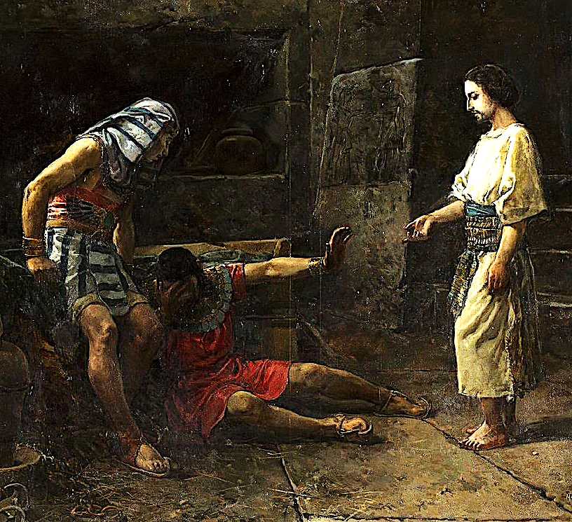
Genesis 40: 16-23
¹⁶When the chief baker saw that the interpretation was good he said to Joseph, “I also was in my dream and behold, three baskets of white bread were on my head. ¹⁷In the uppermost basket there were all kinds of baked food for Pharaoh and the birds ate them out of the basket on my head.”
¹⁸Joseph answered, “This is its interpretation. The three baskets are three days. ¹⁹Within three more days, Pharaoh will lift up your head from off you and will hang you on a tree; and the birds will eat your flesh from off you.” ²⁰On the third day, which was Pharaoh’s birthday, he made a feast for all his servants, and he lifted up the head of the chief cup bearer and the head of the chief baker among his servants. ²¹He restored the chief cup bearer to his position again, and he gave the cup into Pharaoh’s hand; ²²but he hanged the chief baker, as Joseph had interpreted to them. ²³Yet the chief cup bearer didn’t remember Joseph, but forgot him.

Slide 17
Questions
Why did the prison warden put Joseph in charge of everything?
Why did God bless Joseph in his work and his talent for interpreting dreams? What qualities of Joseph made him worthy of these blessings? (Hint: Gen 39:9, 40:8, 41:16)

Slide 18
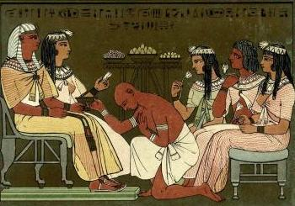
Genesis 41: 8-15
⁸In the morning, the Pharaoh’s spirit was troubled, and he sent and called for all of Egypt’s magicians and wise men. Pharaoh told them his dreams, but there was no one who could interpret them to Pharaoh.
⁹Then the chief cup bearer spoke to Pharaoh, saying, “I remember my faults today. ¹⁰Pharaoh was angry with his servants, and put me in custody in the house of the captain of the guard, with the chief baker. ¹¹We dreamed a dream in one night, he and I. Each man dreamed according to the interpretation of his dream. ¹²There was with us there a young man, a Hebrew, servant to the captain of the guard, and we told him, and he interpreted to us our dreams. He interpreted to each man according to his dream. ¹³ As he interpreted to us so it was. He restored me to my office and he hanged him.”
¹⁴Then Pharaoh sent and called Joseph and they brought him hastily out of the dungeon. He shaved himself, changed his clothing, and came in to Pharaoh. ¹⁵Pharaoh said to Joseph, “I have dreamed a dream, and there is no one who can interpret it. I have heard it said of you that when you hear a dream you can interpret it.”

Slide 19
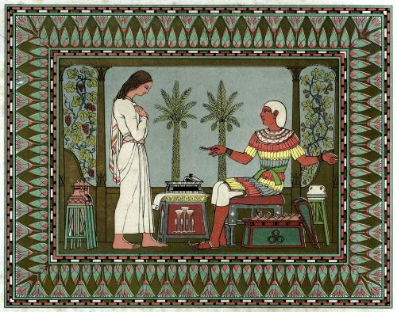
Genesis 41: 16-24
¹⁶Joseph answered Pharaoh, saying, “It isn’t in me. God will give Pharaoh an answer of peace.”
¹⁷Pharaoh spoke to Joseph, “In my dream, behold, I stood on the brink of the river; ¹⁸and behold, seven fat and sleek cattle came up out of the river. They fed in the marsh grass; ¹⁹and behold, seven other cattle came up after them, poor and very ugly and thin, such as I never saw in all the land of Egypt for ugliness. ²⁰The thin and ugly cattle ate up the first seven fat cattle; ²¹and when they had eaten them up, it couldn’t be known that they had eaten them, but they were still ugly, as at the beginning. So I awoke. ²²I saw in my dream, and behold, seven heads of grain came up on one stalk, full and good; ²³and behold, seven heads of grain, withered, thin, and blasted with the east wind, sprung up after them. ²⁴The thin heads of grain swallowed up the seven good heads of grain. I told it to the magicians but there was no one who could explain it to me.”

Slide 20
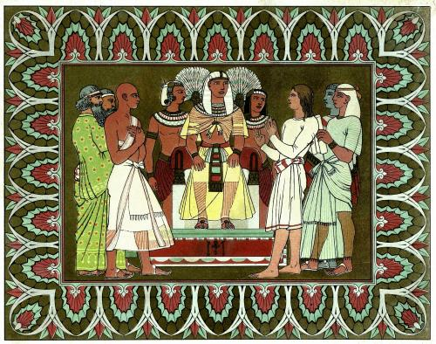
Genesis 41: 25-28, 32-36
²⁵Joseph said to Pharaoh, “The dreams of Pharaoh are one. What God is about to do he has declared to Pharaoh. ²⁶The seven good cattle are seven years; and the seven good heads of grain are seven years. ²⁷The seven thin and ugly cattle that came up after them are seven years, and also the seven empty heads of grain blasted with the east wind; they will be seven years of famine. ²⁸That is the thing which I have spoken to Pharaoh. God has shown Pharaoh what he is about to do…
³²The dream was given to Pharaoh, because the thing is established by God, and God will shortly bring it to pass. ³³“Now therefore let Pharaoh look for a discreet and wise man, and set him over the land of Egypt. ³⁴Let Pharaoh do this and let him appoint overseers over the land, and take up the fifth part of the land of Egypt’s produce in the seven plenteous years. ³⁵Let them gather all the food of these good years that come, and store grain under the hand of Pharaoh for food in the cities, and let them keep it. ³⁶The food will be to supply the land against the seven years of famine which will be in the land of Egypt; so that the land will not perish through the famine.”

Slide 21
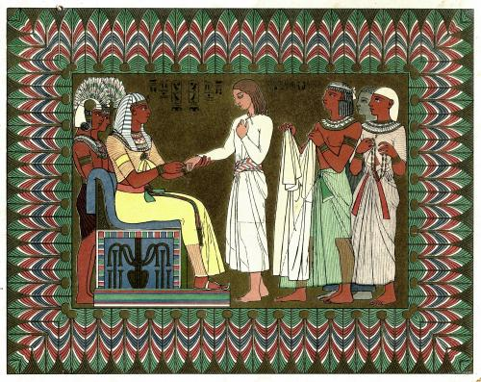
Genesis 41: 37-42
³⁷The thing was good in the eyes of Pharaoh, and in the eyes of all his servants. ³⁸Pharaoh said to his servants, “Can we find such a one as this, a man in whom is the Spirit of God?” ³⁹Pharaoh said to Joseph, “Because God has shown you all of this, there is no one so discreet and wise as you.
⁴⁰You shall be over my house. All my people will be ruled according to your word. Only in the throne I will be greater than you.” ⁴¹Pharaoh said to Joseph, “Behold, I have set you over all the land of Egypt.” ⁴²Pharaoh took off his signet ring from his hand, and put it on Joseph’s hand, and arrayed him in robes of fine linen, and put a gold chain about his neck.

Slide 22
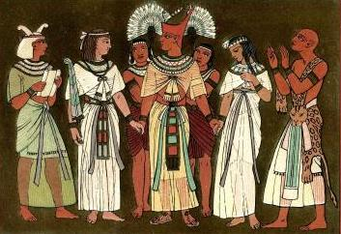
Genesis 41: 45-52
⁴⁵Pharaoh called Joseph’s name Zaphenath-Paneah. He gave him Asenath, the daughter of Potiphera priest of On as a wife. Joseph went out over the land of Egypt.
⁴⁶Joseph was thirty years old when he stood before Pharaoh king of Egypt. Joseph went out from the presence of Pharaoh, and went throughout all the land of Egypt. ⁴⁷In the seven plenteous years the earth produced abundantly. ⁴⁸He gathered up all the food of the seven years which were in the land of Egypt, and laid up the food in the cities. He stored food in each city from the fields around that city.
⁴⁹Joseph laid up grain as the sand of the sea until he stopped counting for it was without number. ⁵⁰To Joseph were born two sons before the year of famine came, whom Asenath, the daughter of Potiphera priest of On, bore to him. ⁵¹Joseph called the name of the firstborn Manasseh, “For”, he said, “God has made me forget all my toil, and all my father’s house.” ⁵²The name of the second, he called Ephraim: “For God has made me fruitful in the land of my affliction.”

Slide 23
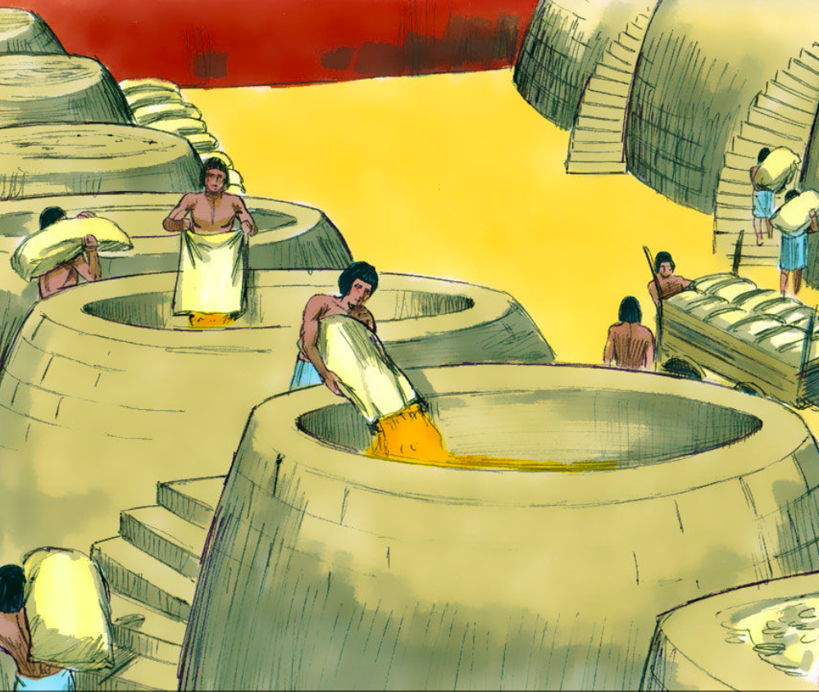
Genesis 41: 53-57
⁵³The seven years of plenty, that were in the land of Egypt, came to an end. ⁵⁴The seven years of famine began to come, just as Joseph had said. There was famine in all lands, but in all the land of Egypt there was bread. ⁵⁵When all the land of Egypt was famished the people cried to Pharaoh for bread and Pharaoh said to all the Egyptians, “Go to Joseph. What he says to you, do.” ⁵⁶The famine was over all the surface of the earth. Joseph opened all the store houses, and sold to the Egyptians. The famine was severe in the land of Egypt. ⁵⁷All countries came into Egypt, to Joseph to buy grain, because the famine was severe in all the earth.
Downloaded from FreeBibleimages.org

Slide 24
Questions
In what regard was the Pharaoh a wise ruler?
How many children did Joseph have with his Egyptian wife?

Slide 25
Acknowledgments:
Scripture verses were taken from the World English Bible and edited for clarity.
Unless otherwise indicated, all images were downloaded from Wikimedia.
Most of the questions are derived from commentary from “The Rational Bible: Genesis” by Dennis Prager.

